Slide 1


Feb. 2025
Address
4701 SW Admiral Way Unit#36
Sattle,WA 98116
423-839-3523
Website
www.pillardrugclub.com

Slide 2





Feb. 2025
About Us
As a pharmacist for eight years, I saw how the industry’s inefficiencies forced employers to pay inflated prices for the same maintenance medications, driving up costs with no real benefit. Khelan Patel and I knew there had to be a better way—one that eliminated waste, reduced costs, and gave employers true control over their pharmacy spend. That’s why we founded Pillar Drug Club, introducing an annual supply model that streamlines fulfillment, cuts unnecessary claims, and creates cost predictability. We’re passionate about changing healthcare by making pharmacy simpler, more transparent, and finally designed to work for the people who pay for it.

Slide 3




Feb. 2025
Problem
For years, employers have navigated the ruins of a broken pharmacy system, where inefficiency is built into every prescription filled. Medications that should be simple to manage become a revolving door of claims, fees, and rising costs, with no real transparency or control. Employees struggle with inconsistent pricing and missed refills, while employers absorb the waste of a system designed to keep them spending. The result? Higher costs, lower adherence, and a process that serves the industry more than the people paying for it. It’s time for a smarter, more efficient way forward.
The Society
The Environment
The Climate
A system where employers bear the burden of rising drug costs, trapped in a cycle of inefficiency that prioritizes profit over affordability and access.
A healthcare landscape where cost volatility, administrative waste, and misaligned incentives make managing prescription benefits an uphill battle for employers.
A growing demand for cost transparency and efficiency, as employers seek smarter solutions to rein in pharmacy spending without compromising employee health..

Slide 4


Feb. 2025
Average Drug Spend
Average Generic Spend for Self Insured Employers: $252/yr
Average Out of Pocket for Employees: $336/yr
Total Drug Spend: $588/yr
Pillar Drug Club has the formula to drop these cost dramatically (over 50%!)

Slide 5



Feb. 2025
SOLUTIONS
BI/ANNUAL MODEL
PREDICTABILITY
Eliminates monthly claims and dispensing fees, reducing costs and administrative burden.
Provides upfront, transparent costs so employers can budget with confidence.
STREAMLINED
BETTER UX
Pillar Drug Club replaces inefficiency with simplicity by offering an annual supply model that eliminates excess claims, reduces dispensing fees, and provides predictable costs for employers. By streamlining fulfillment and cutting administrative waste, we lower pharmacy spend while improving medication adherence. This is a smarter, more transparent way to manage prescription benefits—one that finally puts employers in control.
Reduces waste and inefficiencies, ensuring employees receive medications without disruption.
Fewer hassles, better access, and a seamless experience improve employee satisfaction and trust.

Slide 6
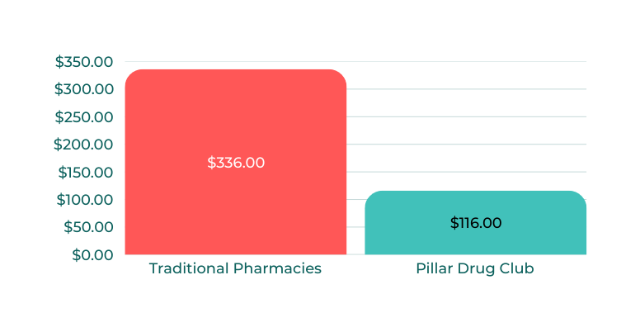
Feb. 2025
Partnership Model
Wholesale cost/year (generics)
Wholesale Pricing: Members get biannual and annual medication supplies at wholesale acquisition cost with no markups.
Subscription-Based: An annual fee covers access, reducing drug costs and improving adherence.
Seamless Integration: Works with PBMs without disrupting existing benefits.
Lower Costs: Bulk purchasing helps employers reduce total pharmacy spend.
Better Outcomes: Simplifies access, boosts adherence, and improves health.
$29.00/drug/year
Annual OOP of +4 RXs/ patient
*
Average of 65.5%
saving vs Traditional Pharmacies
*Prescription Drug Trends.â€ KFF, 2023, https://www.kff.org/health-costs/issue-brief/prescription-drug-trends/. Accessed February 2025.

Slide 7


Feb. 2025
Foundation Plan
Product
Overview
$60 upfront + $5 PEPM
A strong base for cost control, with employers paying $5 per employee per month.
Covers pharmacy services (labor + shipping) for up to 4 medications
Pillar Drug Club (PDC) offers a smarter, cost-effective way to manage prescription benefits, eliminating inefficiencies and reducing costs for employers and employees. With an bi/annual supply model, we streamline fulfillment, lower claims volume, and provide predictable pharmacy spend.
Keystone Plan
$120 Upfront + $10 PEPM
Covers labor, and shipping costs for 5 or more medications
Ideal for high-utilization employees for managing complex therapies

Slide 8
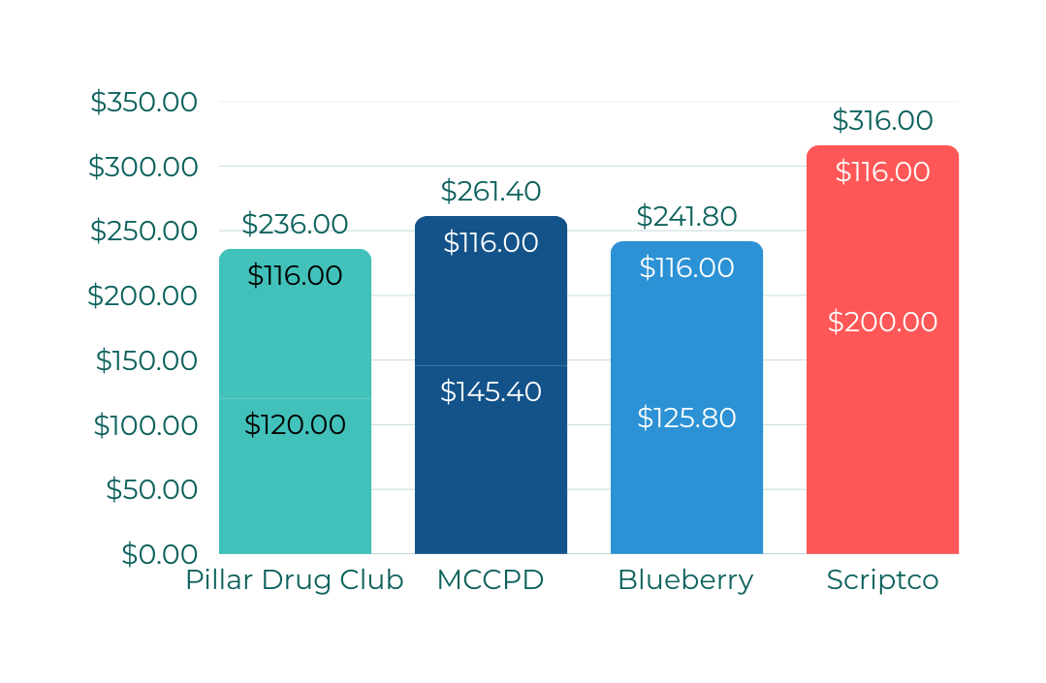
Feb. 2025
Competitive Analysis
Annual Cost for 4 Generic Medications at $116
Cost-Controlled & Transparency
When comparing Pillar Drug Club, Mark Cuban Cost Plus Drugs, Blueberry Pharmacy, and ScriptCo, Pillar Drug Club stands out for its predictable, low-cost model—without the risk of percentage-based markups inflating costs.
Pillar Drug Club: $236 total, with $120 in admin costs, ensuring affordability and stability for employers.
Mark Cuban Cost Plus Drugs: $244.00 total, with a 15% markup that can skyrocket costs for expensive drugs.
Blueberry Pharmacy: $241.80 total, with $125.80 in admin fees, offering no pricing advantage or predictability.
ScriptCo: $316 total, with $200 in admin fees, making it the priciest option.
Mark Cuban’s model is still close—until an expensive drug comes in. Then, that 15% markup isn’t so friendly.

Slide 9




Feb. 2025
Pillars of Success
Premier Patient Care:
Less time spent on dispensing means more time focused on patient support and well-being.
Efficiency Focused:
Our streamlined model eliminates unnecessary costs and complexity, ensuring seamless medication access.
Aligned Incentives:
No markups, we focus on driving savings and value—not profiting off higher drug prices.

Slide 10

Feb. 2025
Seamless Integration
Access
to Admin
Portal
Pharmacy
Services
Rendered
Contract Negotiation
Employee
Engagement
Contract Execution
Admin
Reports
Employee
enrollment
Fulfillment &
Reporting

Slide 11
Feb. 2025
Thank You
Experience the savings firsthand. Get a free cost analysis of your current pharmacy spend versus Pillar Drug Club. Contact us at seth@pillardrugclub.com to start your free claims assessment today!
4701 SW Admiral Way Unit#336
Seattle, WA 98116
423-839-3523
www.pillardrugclub.com

